Slide 1
CISC320: Dungeons and Dragons Interactive Character Sheet
Aquarius: Catherine, Torrencio, Mushy, Sophie, Rachel

Slide 2
Group Members
Torrencio – Project Manager/Logic Architect
Sophie Beland – Lead Architect/Parser
Catherine – GUI Architect
Mushy – GUI Architect
Rachel – Logic Architect

Slide 3
What is DnD?
Dungeons & Dragons (abbreviated as D&D or DnD) is a fantasy tabletop role-playing game.
D&D assigns each player a specific character to play. These characters embark upon imaginary adventures within a fantasy setting.
A Dungeon Master serves as the game's referee and storyteller.
The characters form a party that interacts with the setting's inhabitants (and each other). Together they solve dilemmas, engage in battles and gather treasure and knowledge.
Source: http://en.wikipedia.org/wiki/Dungeons_%26_Dragons
Notes:
Tori

Slide 4
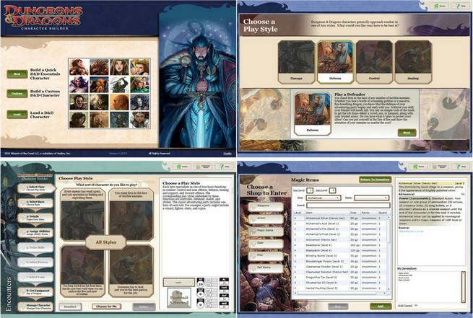
Character Creator
Notes:
Tori

Slide 5
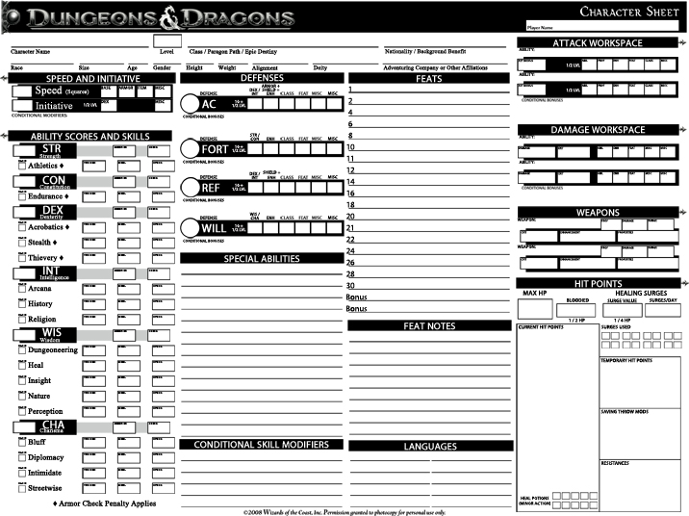
Character Sheet
Notes:
Tori

Slide 6
Interactive Character Sheet
Create a less cluttered character sheet with required information readily available
The user should be able to interactive with the sheet on a tablet or phone. Some examples:
Change Health
Use Abilities
Change possessions
Add Condition
Tracks which abilities have been/can be used
The application will allow users to modify the sheet’s data on the fly
Notes:
Sophie

Slide 7
What We Are Doing
Parsing
Logic
GUI
Sophie
Mushy
Catherine
Torrencio
Rachel
Notes:
Sophie

Slide 8
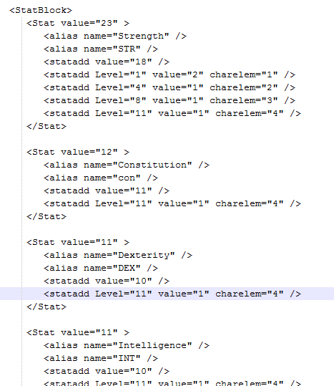
Parsing
The character creator exports a very large (15k words!) XML file with information on the character
File needs to be parsed for required information and put into appropriate data structures
Notes:
sophie

Slide 9
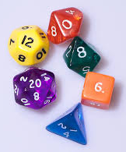
Logic
Processes the parsed data to be displayed in the GUI
Adjusts character stats and attributes based on player actions
Logic for dice rolls and other calculations
http://upload.wikimedia.org/wikipedia/commons/e/e5/Dice_%28typical_role_playing_game_dice%29.jpg
Notes:
tori

Slide 10
GUI
Notes:
catherine

Slide 11
Stats
Skills
Abilities
Items/Gold
Cacciatore
Ability Score Check
STR 23 11
CON 12 6
DEX 11 5
INT 11 5
WIS 9 4
CHA 17 8
Action Points: 1
Use
Second Wind: 1
Use
Initiative 7
Speed 5
Passive Insight 14
Passive Perception 14
Special Senses: Normal
Languages: Common, Dwarven
HP : 23/74
+
-
Bloodied
Surges Left: 7/8
Use surge
Defenses
AC 25
FORT 25
REF 19
WILL 22
Resistances/Vulnerabilities:
End Turn
New Encounter
New Day

Slide 12
Stats
Skills
Abilities
Items/Gold
Cacciatore
Skill | Score
Acrobatics | 4
Arcana | 5
Athletics | 15
Bluff | 8
Diplomacy | 13
Dungeoneering | 4
Endurance | 10
Heal | 9
History | 5
Insight | 4
Intimidate | 13
Nature | 4
Perception | 4
Religion | 5
Stealth | 6
Streetwise | 8
Thievery | 4
End Turn
New Encounter
New Day

Slide 13

Stats
Skills
Abilities
Items/Gold
Cacciatore
Used
Melee Basic
Viper’s Strike
At-Will – Standard Action
Melee weapon
Target: One creature
Keywords: Martial, Weapon
Attack: Strength vs. AC
Hit: 1[W] + Str modifier damage
Effect: If the target shifts before the start of your next turn, it provokes an opportunity attack from an ally of your choice.
Additional Effects: +2 to damage rolls when charging
Ranged Basic Attack
Viper’s Strike
Wolf Pack Tactics
USE ATTACK
End Turn
New Encounter
New Day

Slide 14
Stats
Skills
Abilities
Items/Gold
Cacciatore
GOLD : 45 P 4 G 123 S 4 C
+
-
Items
Equipment
Head
Neck
Arms
Rings
Hands | Dual-Threat Gauntlets | Details
Main Hand | Chieftan’s Spear | Details
Off Hand
Waist
Armor | Joyous Chainmail | Details
Feet
Tatoo
Ki Focus
- crowbar
End Turn
New Encounter
New Day

Slide 15
Main Challenges
Parsing a really big file – filtering out relevant information
Integration between parsing, logic, and GUI
Making the GUI user friendly
Good performance – DnD is a fast paced game!
Notes:
rachel

Slide 16
Timeline
Week 7 – 8 – Make Decisions and Code
Logic decides what is needed from parser
GUI decides what info they want to display
Parser has data in format Logic can use
GUI gets as much data in a possible
Week 9 – Code, code, code
Goal is to have information going from text file all the way up to GUI
Have a rough GUI with all of data on it
Week 10-11 – Finishing up
add functionality to data GUI
refine final design
Week 4 - Planning
Finish planning
Finish functional analysis document
Start researching libraries
Learn to play Dungeon and Dragons!
Week 5 – Start Coding
Start GUI Frames
Start parsing
Decide on data format/data structure
Decide on libraries being used
Notes:
rachel

Slide 17
Progress So Far
Finished RAD document (use cases, requirements)
Environment chosen and set up
Logged into SVN
Designed GUI
Played a DnD game!
Notes:
rachel

